Slide 1
Welcome To The Hume Volunteer Trivia Quiz
In this quiz you are presented with six categories of five questions each. To navigate around the quiz:
1
= Click on the numbered button to go to the question.
= Click on the information button to reveal the answer.
= Click on the return button to go back to the main screen.
= Click on the play button to play sound for the music and quotes questions
Make sure your speakers are on and the volume is turned up
Click here to START

Slide 2
About Hume
“Old Time”
Music
Film
Quotes
Who Is That
General Knowledge
About Volunteers
1
6
11
16
21
26
2
7
12
17
22
27
3
8
13
18
23
28
4
9
14
19
24
29
5
10
15
20
25
30

Slide 3
How many Councillors does Hume have?
10
Correct Answer
A
B
11
C
12
D
13
1
Click here for answer
Click here to return to main screen

Slide 4
Roughly, what is the current population of Hume?
A
142,345
B
159,267
Correct Answer
C
194,006
D
226,258
2
Click here for answer
Click here to return to main screen

Slide 5
Approximately, how many languages other than English are spoken in Hume
A
85
B
120
Correct Answer
C
140
D
165
3
Click here for answer
Click here to return to main screen

Slide 6
Approximately, how many jobs exist in Hume?
63,625
Correct Answer
A
B
71,038
C
82,647
D
92,443
4
Click here for answer
Click here to return to main screen

Slide 7
How many Postcodes are represented in the City of Hume
25
Correct Answer
A
B
27
C
29
D
31
5
Click here for answer
Click here to return to main screen

Slide 8
Pick The Song
Click here to play sound
Peter Gunn Theme - Duanne Eddy
Pipeline - The Chantays
A
B
Green Onions - Booker T
Apache - The Shadows
C
Correct Answer
D
6
Click here for answer
Click here to play sound
Click here to return to main screen

Slide 9
Pick The Song
Click here to play sound
Black Is Black - Los Bravos
Back In Black - AC/DC
Correct Answer
A
B
I Got A Woman - Ray Charles
Cupid - Sam Cooke
C
D
7
Click here for answer
Click here to play sound
Click here to return to main screen

Slide 10
Pick The Song
Click here to play sound
Correct Answer
House Of The Rising Sun - The Animals
A
Satisfaction - The Rolling Stones
B
C
On The Road Again - Canned Heat
D
Wishing Well - Free
8
Click here for answer
Click here to play sound
Click here to return to main screen

Slide 11
Pick The Song
Click here to play sound
Wishing Well - Free
In The Midnight Hour - Wilson Pickett
A
B
Louie Louie - The Kingsmen
Correct Answer
Mr. Pitiful - Otis Redding
C
D
9
Click here for answer
Click here to play sound
Click here to return to main screen

Slide 12
Pick The Song
Click here to play sound
I Heard It Through The Grapevine - Marvin Gaye
Correct Answer
Mr. Pitiful - Otis Redding
A
B
Tired Of Being Alone - Al Green
Green Onions - Booker T & The MG’s
C
D
10
Click here for answer
Click here to play sound
Click here to return to main screen

Slide 13
What film is this from….
Click here to play sound
I eat breakfast 300 yard from 4,000 Cubans who are trained to kill me……..
A
Correct Answer
Basic Instinct
B
A Few Good Men
C
Chinatown
D
Mars Attacks
11
Click here for answer
Click here to play sound
Click here to return to main screen

Slide 14
What film is this from….
Click here to play sound
Frankly my dear, I don’t give damn
A
Some Like It Hot
B
Casablanca
C
Gone With The Wind
Correct Answer
D
The African Queen
12
Click here for answer
Click here to play sound
Click here to return to main screen

Slide 15
What film is this from….
Click here to play sound
Show me the money……………
A
Correct Answer
B
Jerry Maguire
The Matrix
C
Wall Street
D
The Colour of Money
13
Click here for answer
Click here to play sound
Click here to return to main screen

Slide 16
What film is this from….
Click here to play sound
Go ahead…make my day
A
Sudden Impact
Correct Answer
B
Dirty Harry
C
Magnum Force
D
The Enforcer
14
Click here for answer
Click here to play sound
Click here to return to main screen

Slide 17
What film was this from….
Click here to play sound
I’ll be back……..
A
Correct Answer
Terminator 2
B
The Terminator
C
Terminator Salvation
D
Terminator Genisys
15
Click here for answer
Click here to play sound
Click here to return to main screen

Slide 18
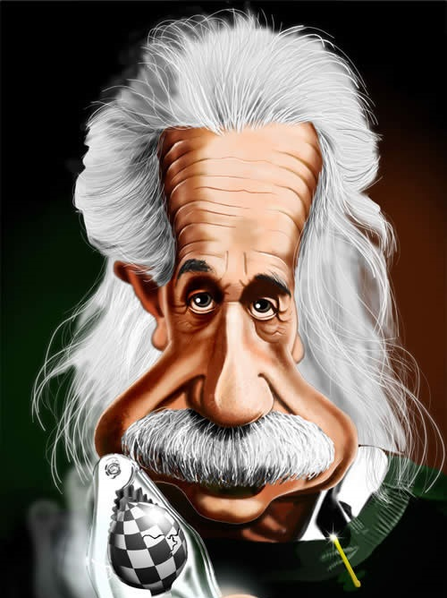
This is………..
A
Albert Einstein
Correct Answer
B
Mark Twain
C
George Custer
D
Oscar Wilde
16
Click here for answer
Click here to return to main screen

Slide 19
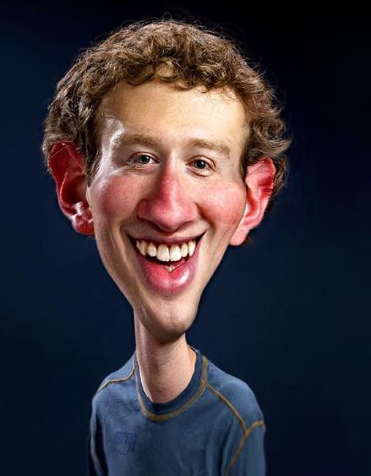
This is………..
A
Steve Wozniak
B
Bill Gates
C
Mark Zuckerberg
Correct Answer
D
Alfred E. Neuman
17
Click here for answer
Click here to return to main screen

Slide 20
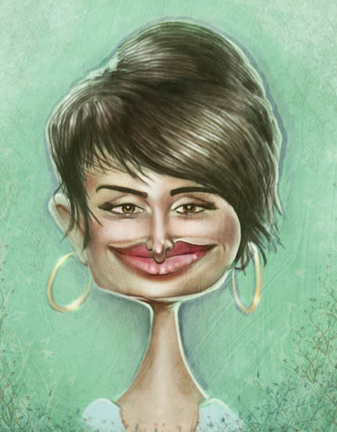
This is………..
A
Chrissie Hynde
B
Demi Moore
C
Angela Jolie
D
Penelope Cruz
Correct Answer
18
Click here for answer
Click here to return to main screen

Slide 21
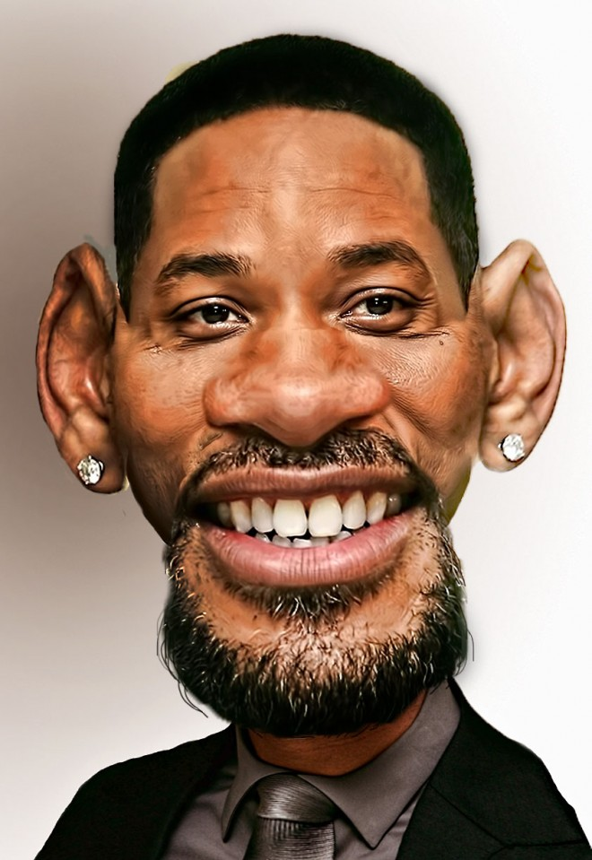
This is………..
A
Denzel Washington
B
Morgan Freeman
C
Jamie Foxx
D
Correct Answer
Will Smith
19
Click here for answer
Click here to return to main screen

Slide 22
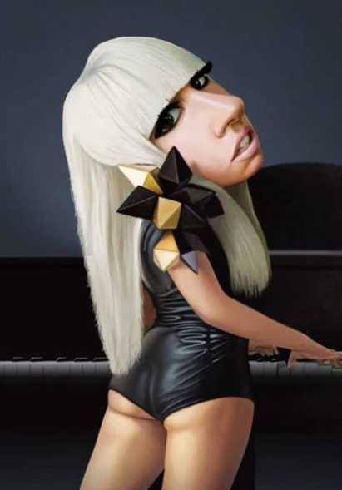
This is………..
Correct Answer
A
Lady Gaga
B
Madonna
C
Annie Lennox
D
Britney Spears
20
Click here for answer
Click here to return to main screen

Slide 23
Of the twelve signs of the Zodiac which one is known as The Fish?
Correct Answer
A
Pisces
B
Capricorn
C
Aquarius
D
Virgo
21
Click here for answer
Click here to return to main screen

Slide 24
Who is the Premier of Victoria
A
Malcolm Turnbull
B
Jeff Kennett
Correct Answer
C
John Cain
D
Daniel Andrews
22
Click here for answer
Click here to return to main screen

Slide 25
Bulgogi is the national dish of which country?
A
Turkey
B
Romania
Correct Answer
C
Korea
D
Vietnam
23
Click here for answer
Click here to return to main screen

Slide 26
What is the capital of Finland?
Correct Answer
A
Helsinki
B
Oslo
C
Copenhagen
D
Stockholm
24
Click here for answer
Click here to return to main screen

Slide 27
What is a group of Crows called?
Correct Answer
A
Murder
B
Assassination
C
Killing
D
Slaughter
25
Click here for answer
Click here to return to main screen

Slide 28
How many volunteers have found employment as a result of their involvement through the Hume Volunteer Gateway?
Correct Answer
A
210
B
360
C
425
D
490
26
Click here for answer
Click here to return to main screen

Slide 29
How many active volunteers are there currently assisting in Hume City Council roles?
A
214
B
272
Correct Answer
C
307
D
360
27
Click here for answer
Click here to return to main screen

Slide 30
How many volunteers have come through the Hume City Council’s volunteering program since 2005?
A
1,600
B
2,400
Correct Answer
C
3,500
D
4,800
28
Click here for answer
Click here to return to main screen

Slide 31
What is the estimated value of the unpaid labour provided by volunteers in Australia?
A
$3.4 billion
B
$10.5 billion
C
$25.4 billion
Correct Answer
D
$42.6 billion
29
Click here for answer
Click here to return to main screen

Slide 32
Approximately, how many different volunteer positions have there been in Hume City Council in the last year?
A
60
B
70
Correct Answer
C
80
D
95
30
Click here for answer
Click here to return to main screen

